Slide 1

Analytics and Interactive Dashboard on Used Car Market Trends
By:
Nemi Makadia
Smitha Patil
Vamsidhar Boddu
Yash Doshi

Slide 2
OBJECTIVES:
The primary goal of this project is to harness the extensive suite of AWS cloud services to construct an advanced, interactive analytics platform tailored for stakeholders in the used car market.
This platform aims to provide real-time insights, data-driven forecasts, and intuitive visualizations that encapsulate the complexities and dynamics of the used car sales industry.
The dashboard will leverage AWS services to visualize various aspects of car sales, including pricing, condition, mileage, and sales distribution across states.

Slide 3
DATASET DESCRIPTION:
The dataset contains 558837 records of used cars, potentially including 16 variables as below:
Year: the year of the car model.​
Make: the manufacturer of the car.​
Model: the specific model of the car.​
Trim: the level of features or package of the car.​
Body: the body style of the car (e.g., SUV, Sedan, Coupe).​
Transmission: the type of transmission (e.g., Automatic, manual).​
Vin: the Vehicle Identification Number, a unique code for each vehicle.​
State: the US State where the car was sold.​
Condition: a rating or score indicating the condition of the car.​
Odometer: the mileage on the car's odometer at the time of sale.​
Color: the exterior color of the car.​
Interior: the interior type or color of the car.​
Sellingprice: the price at which the car was sold.​
Mmr: the Manheim Market Report value, indicating the car's wholesale value.​
Saledate: the date on which the sale occurred.

Slide 4
AWS SERVICES USED:
AWS S3: Hosts the raw used car transaction dataset.
AWS EC2: Its web service provides secure, resizable compute capacity in the cloud. Its interface allows us to obtain and configure capacity with minimal friction.
AWS Glue: Manages data cataloging and performs ETL operations to clean and transform the dataset.
AWS Athena: Executes interactive SQL queries on the cleaned data stored in Amazon S3.
AWS QuickSight: Provides the interactive dashboard using data and insights generated by Athena and predictive analytics powered by SageMaker.
AWS Elastic Beanstalk: Its used for deploying and scaling web applications and services. We can directly upload code and Elastic Beanstalk automatically handles the deployment—from capacity provisioning, load balancing, and auto scaling

Slide 5
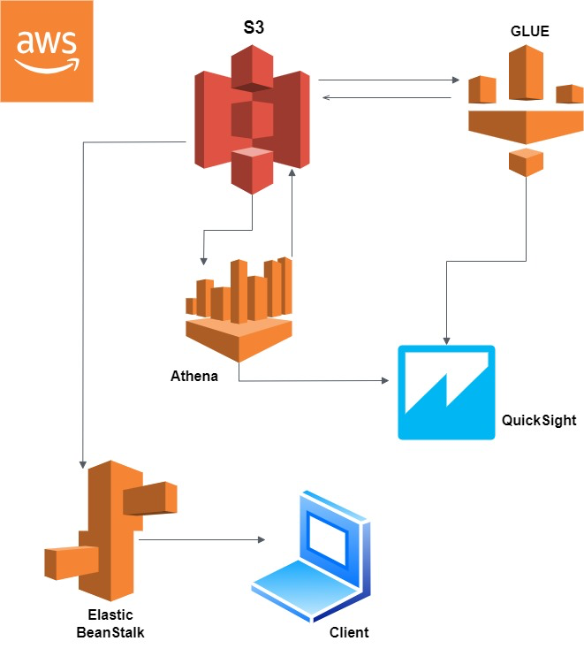
ARCHITECTURE:

Slide 6
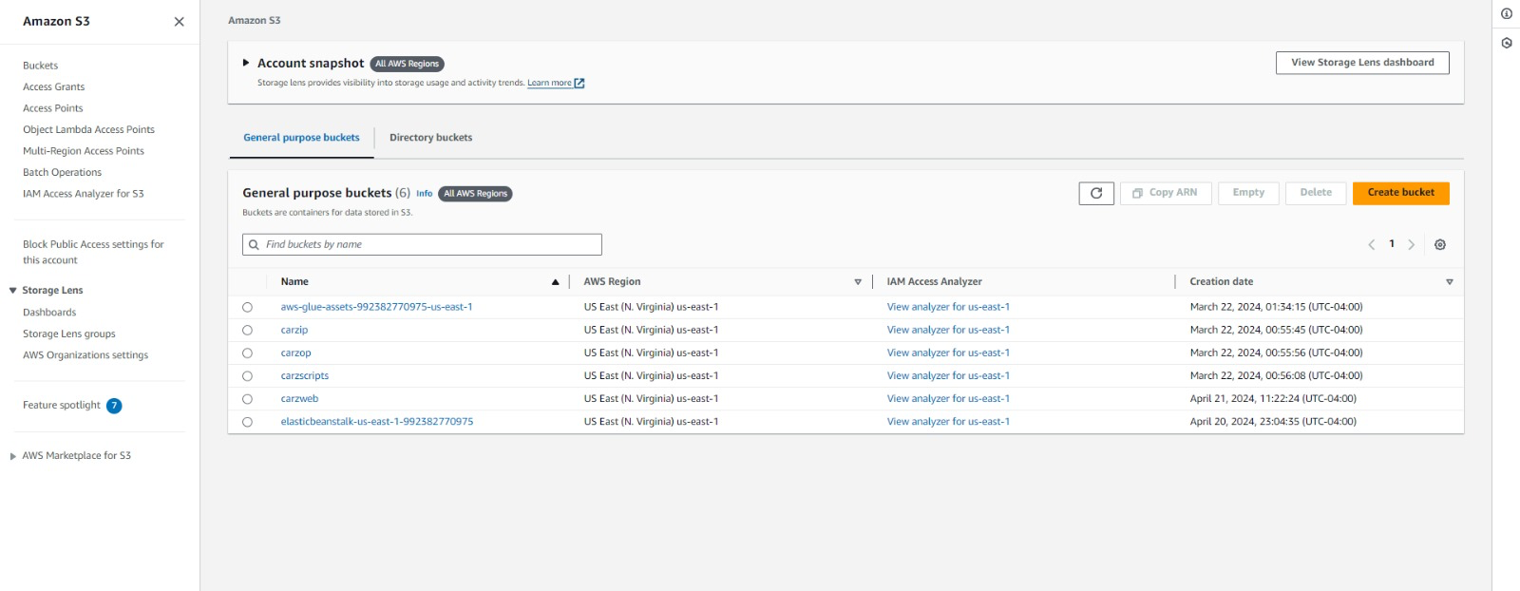
AWS S3(Simple, Secure, Storage):
Buckets of all the operations performed on the AWS

Slide 7
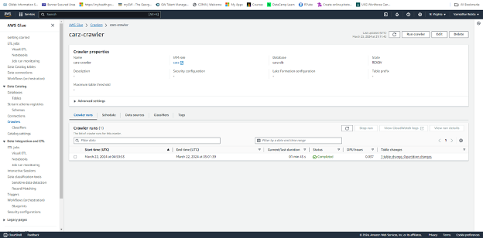
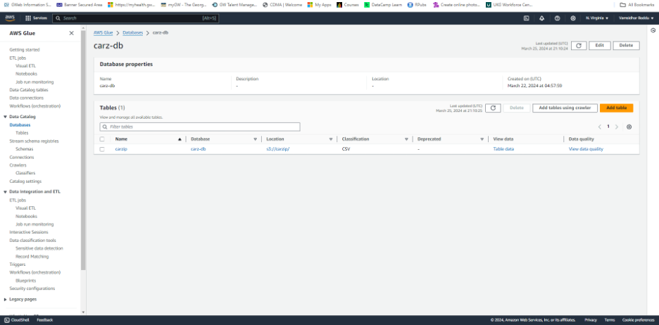
AWS Glue (Data Processing):
The CRAWLER creates the metadata that allows GLUE and services such as ATHENA to view the S3 information as a database with tables.

Slide 8
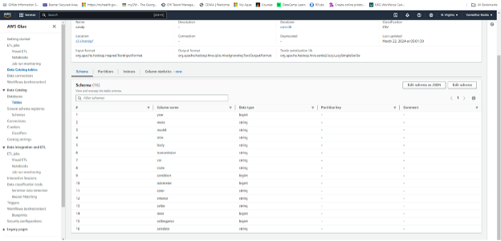
Glue continued...
Representation of the metadata after pre-processing it using AWS Glue

Slide 9
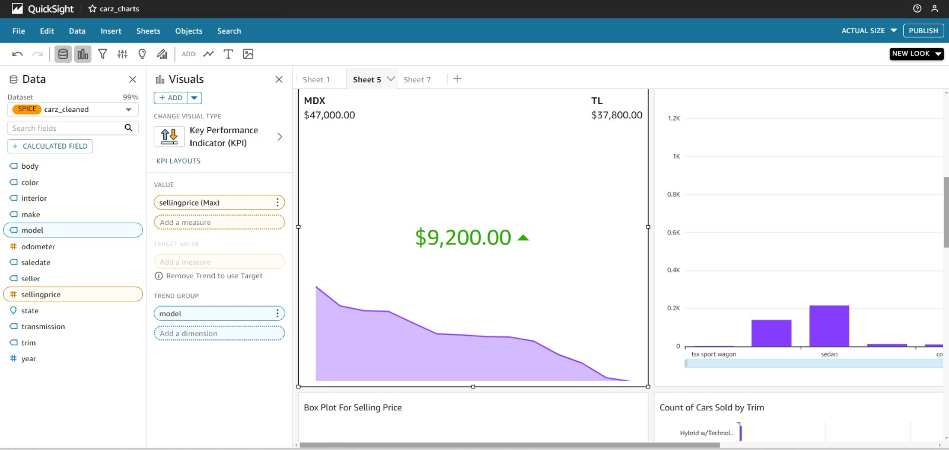
AWS QuickSight
QuickSight interface which has various analysis plots based on the dataset to understand the patterns and trends in the sales of the cars.

Slide 10
KEY VISUALIZATIONS, ANALYTICS AND MODELLING:
Time series analysis of sales volume and pricing trends over time.
Distribution charts comparing sales by car make, model, and states.
Geographic distribution of sales using treemaps, indicating market hotspots.
Correlation analysis to uncover relationships between car features and prices.
Linear Regression Model: The model predict car selling prices based on features like make, model, and year, after preprocessing the data with scaling and one-hot encoding. It also evaluates the model's performance using metrics such as mean squared error, mean absolute error, and R-squared.
Random Forest Model: It uses a RandomForestRegressor to predict car selling prices from features such as make, model, and year after preprocessing. It evaluates the model's accuracy using metrics like mean squared error, mean absolute error, and R-squared.

Slide 11
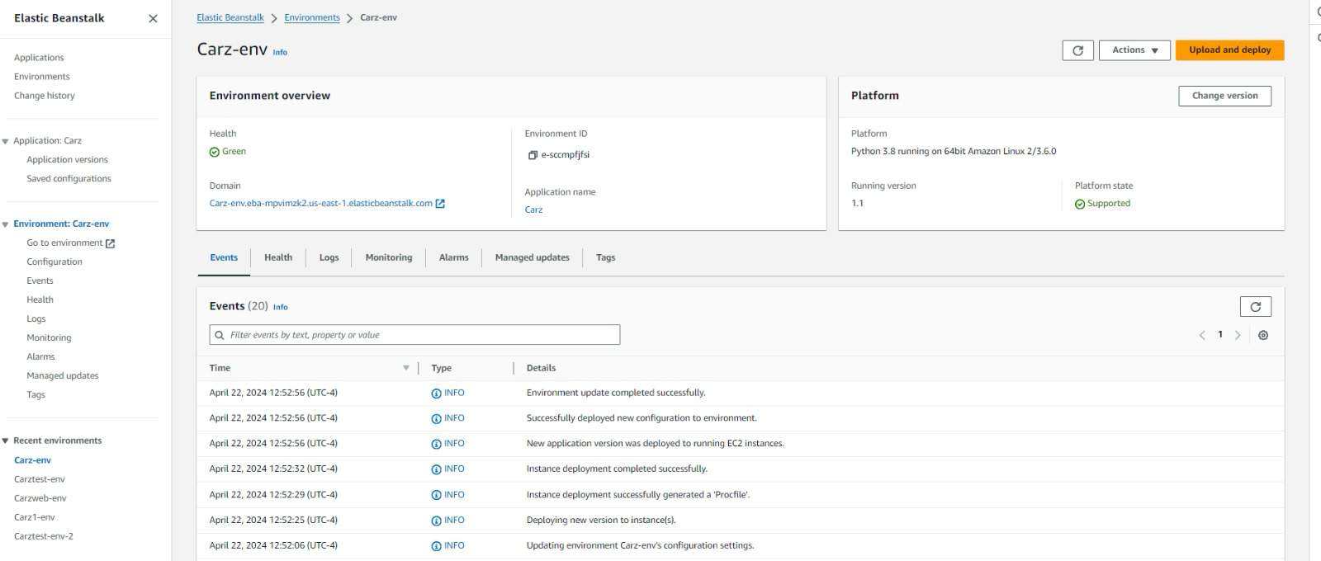
EBS Deployment:
Deployment of the web app using the Elastic Beanstalk service

Slide 12
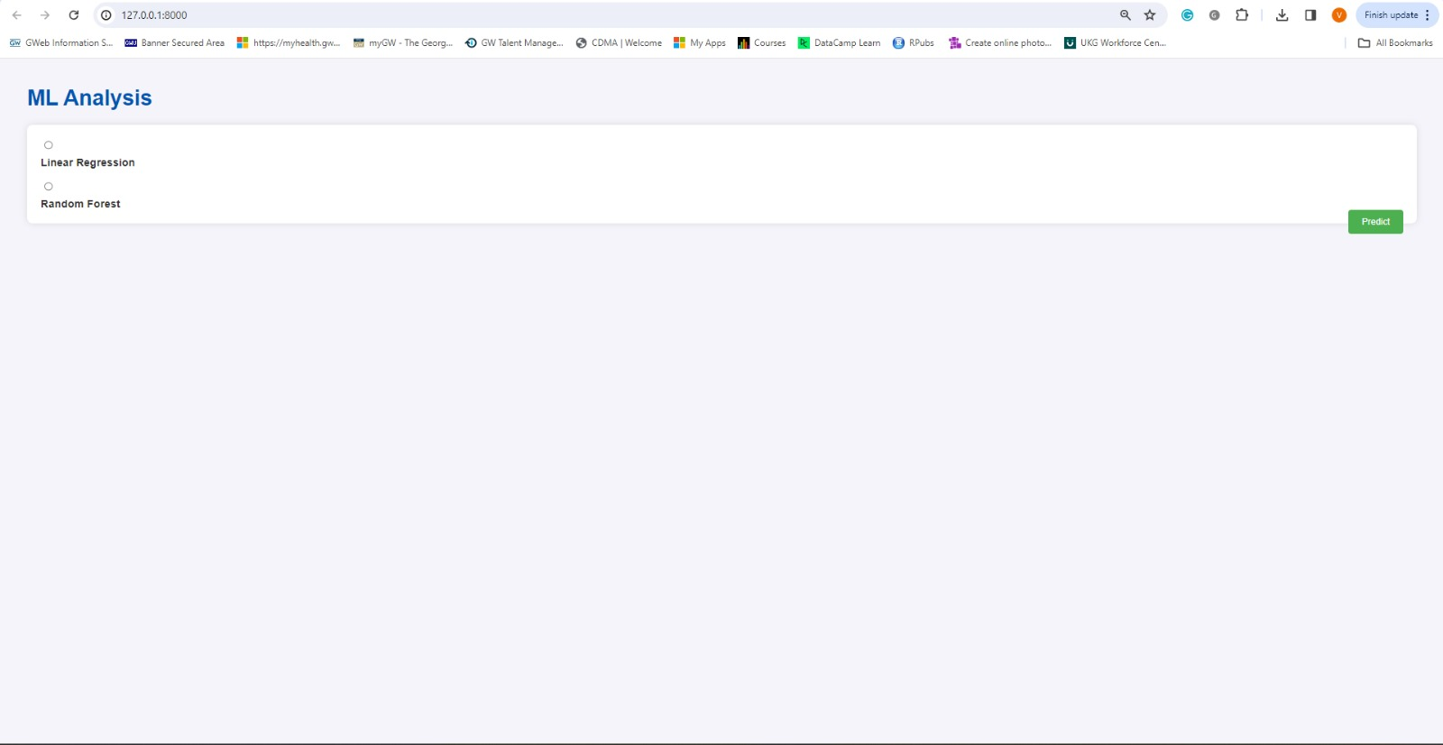
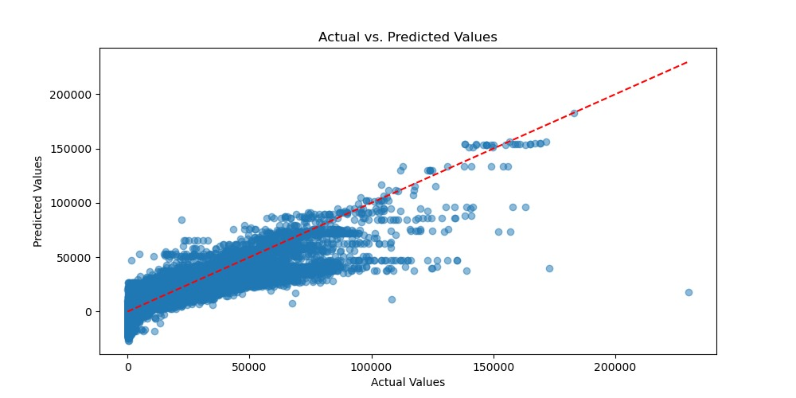
Results from the deployed models:

Slide 13
SCOPE:
Utilizing data to gain insights and strategically navigate the pre-owned vehicle market.
Improved decision-making tools for participants in the used car market, such as dealers, purchasers, and industry analysts.
Capability to detect trends, anomalies, and patterns in vehicle sales data across different parameters.
Efficient data analysis processes, enhanced by AWS services for scalability and improved performance.

Slide 14
REFERENCES:
https://docs.aws.amazon.com/quicksight/
https://docs.aws.amazon.com/athena/
https://docs.aws.amazon.com/glue/
https://aws.amazon.com/elasticbeanstalk/
Link to the GitHub account of the project:
https://github.com/Vamsi-8262/carz_

Slide 15
THANK YOU!

